Slide 1
GCSE Maths

Slide 2
Key Facts
All Year 11 students are entered for the AQA linear course. This means all assessment is at the end of the course
Higher Tier (4 to 9)
Paper 1 – Non Calculator Each paper is 1 hour 30 minutes
Paper 2 – Calculator Allowed
Paper 3 – Calculator Allowed
Foundation Tier (1 to 5)
Paper 1 – Non Calculator Each paper is 1 hour 30 minutes
Paper 2 – Calculator Allowed
Paper 3 – Calculator Allowed

Slide 3
Exam Tips
It is important to note that on higher papers, a significant number of the marks available are on 4 and 5 grade topics.
Likewise at Foundation, 50% of the paper is at Grades 1, 2 and 3.
Pupils should not disregard these topics or the level of work as being “too easy”. They must spend time revising thoroughly. This will ensure students will achieve the best grade possible.
Pupils might find questions easier near the end of the paper so should not give up if they find something difficult in the first half

Slide 5
What should pupils be do doing?
Active Revision – This means doing questions.
Weekly exam papers and homework.
Make revision cards for key topics
Familiarise themselves with the formulae page. Which formulae are given? And which will need to be learnt?
Students should work through the revision list topic by topic. Some topics may need a small amount of time (just a recap). Others may need a lot of time.
Spend time on topics they find difficult.

Slide 6
What can you do to help?
Encourage pupils
Set time or question goals daily or weekly
Suggest revision resources pupils
Testing pupils on formula sheet, key facts or times tables.
Make sure pupils have the correct equipment
Try questions together

Slide 7
What are we doing?
Using lesson time to teach key topics.
Regular exam practice.
Provide feedback and exam analysis.
Intervention lessons.
Revision sessions after school.
Form time revision
Experienced staff are available to support. Students or parents should not feel they are on their own.

Slide 8
Be prepared
Make sure students have the correct equipment for each exam. Many pupils lose marks for being prepared.
Black pens
Pencil
Ruler
Eraser
Compass
Protractor
Calculator – Make sure they know how it works
These should be brought to each lesson not just the exam.

Slide 9
Revision resources
Exercise books and homework task
Exam papers
Revision guides
Maths Watch Online
PIXL Maths APP

Slide 10
Maths Watch
https://vle.mathswatch.co.uk/vle/

Slide 11
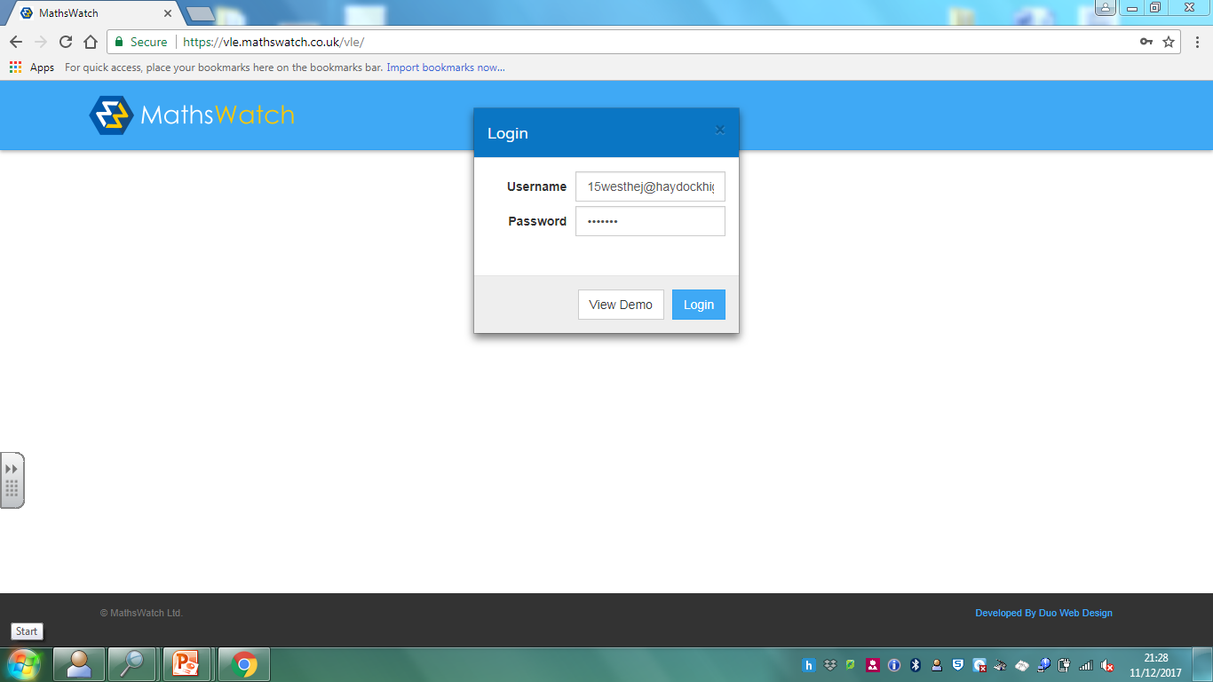

Slide 12
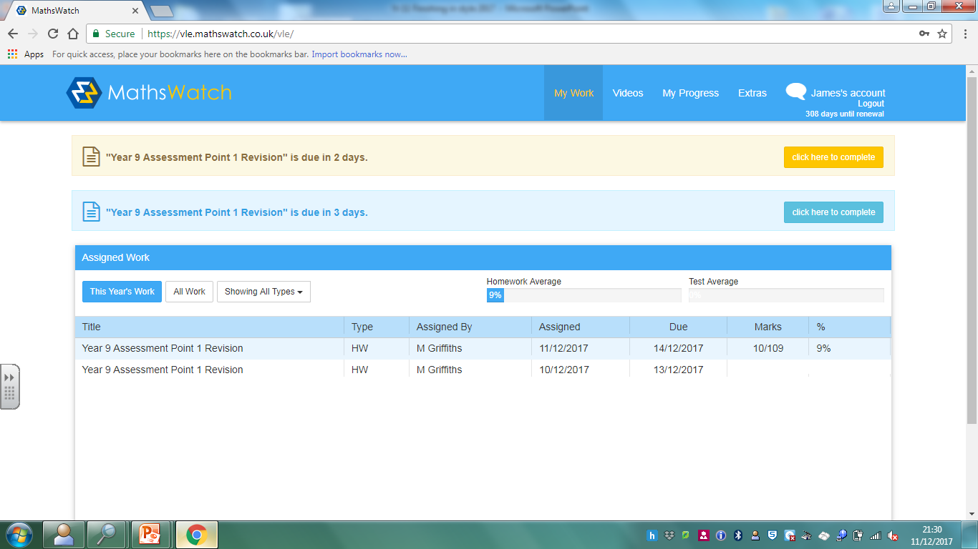

Slide 13
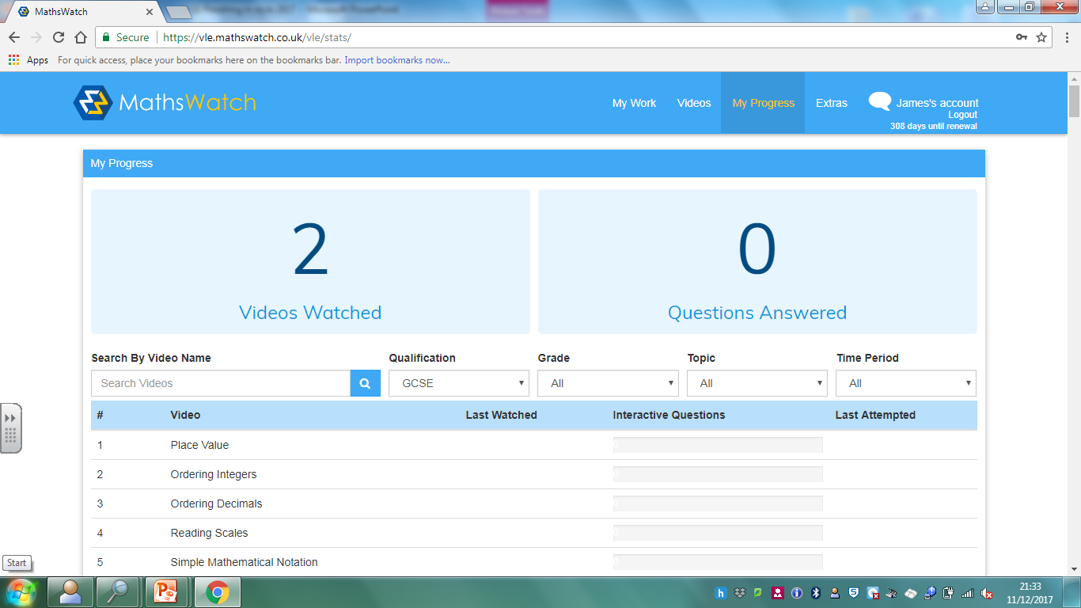

Slide 15
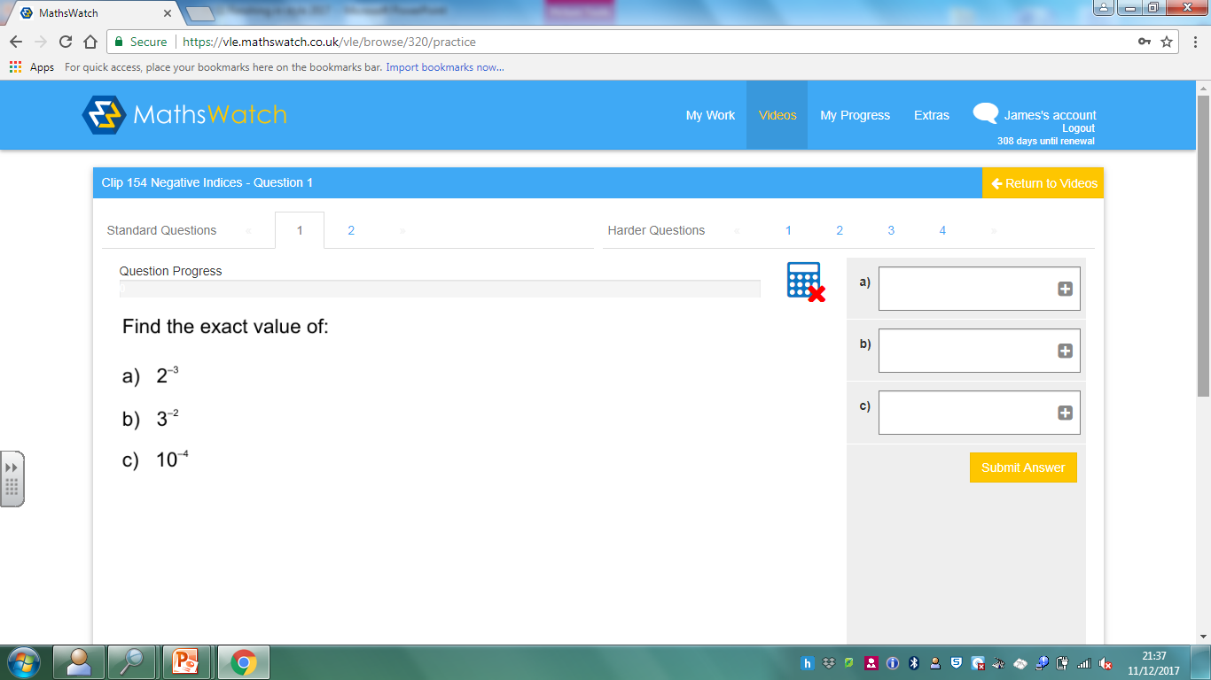

Slide 16
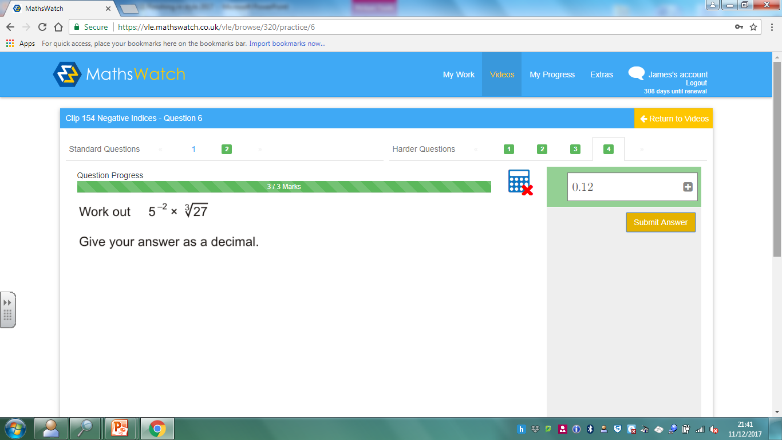

Slide 17
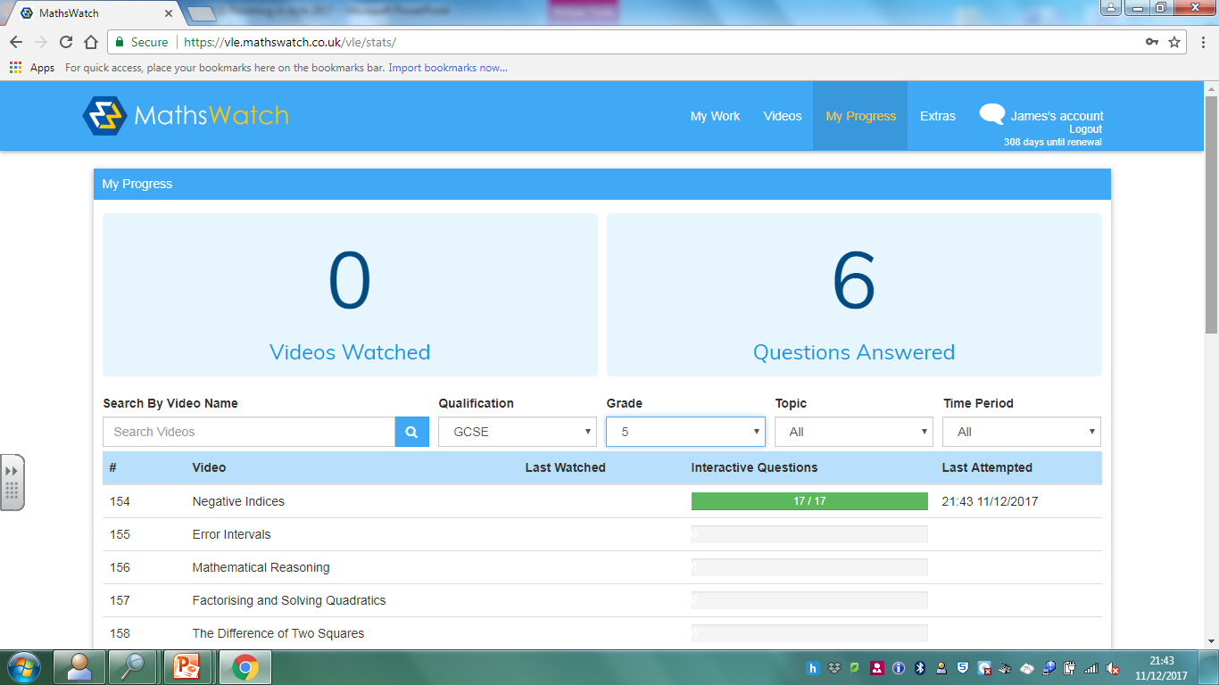

Slide 18
Mr Griffiths Head of Maths
mgriffiths@haydockhigh.sthelens.org.uk

Slide 19
PIXL MATHS APP
https://mathsapp.pixl.org.uk/

Slide 20
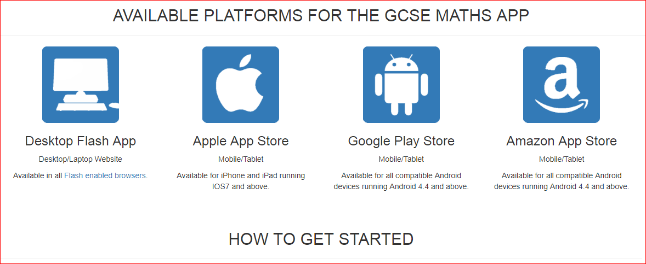

Slide 21
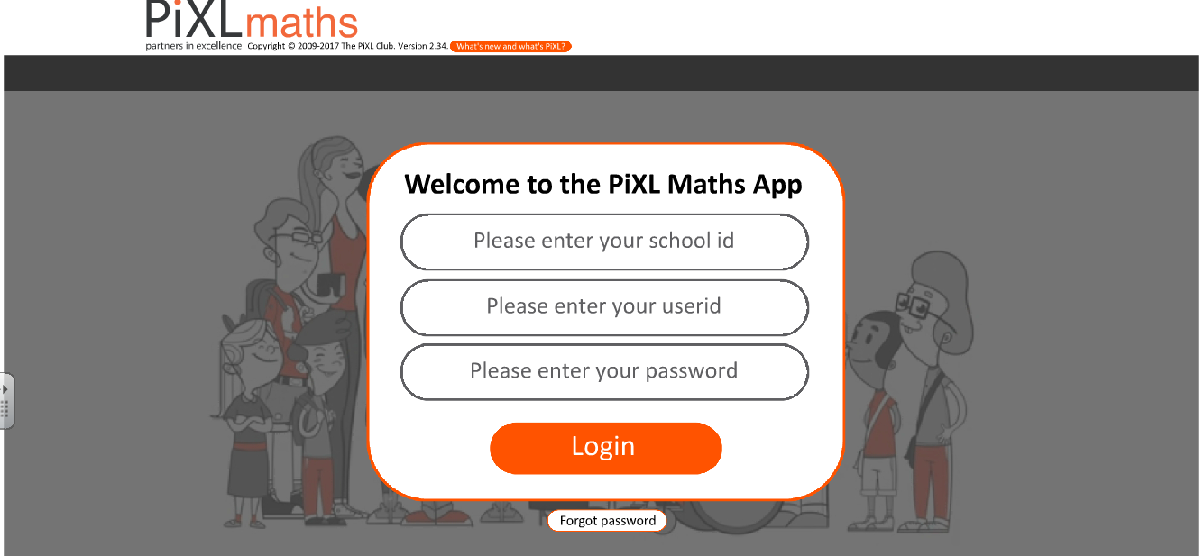

Slide 22
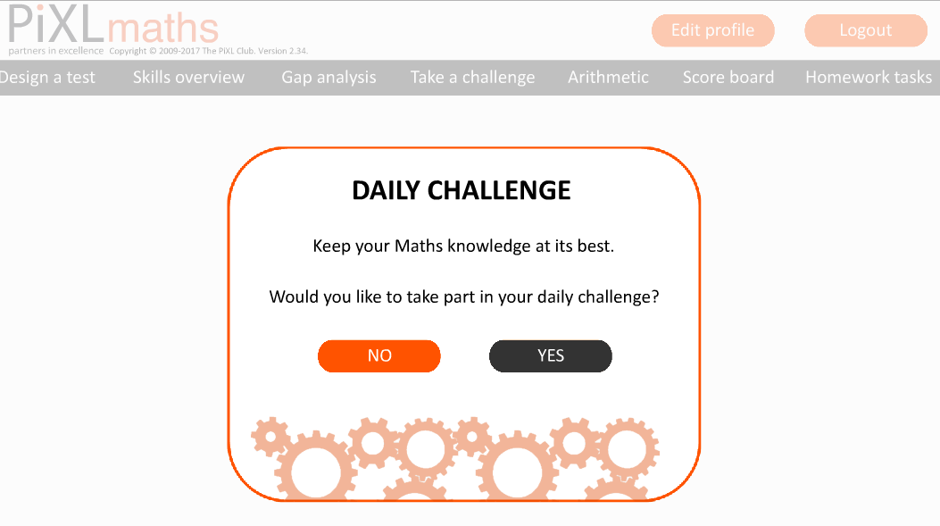

Slide 23
Daily Maths Challenge

Slide 25
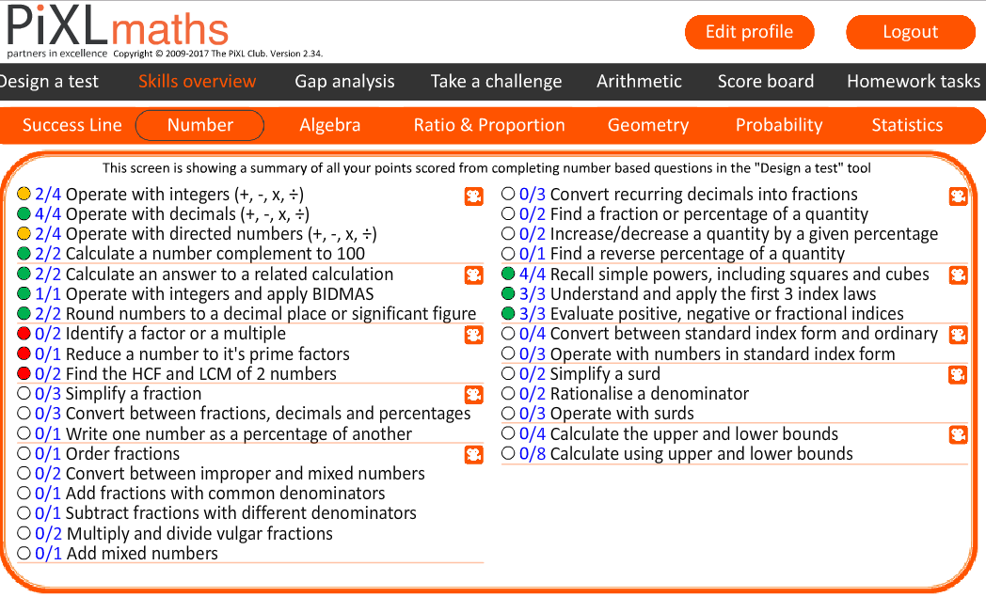

Slide 27
Summary
Each app includes:
All topics for Higher and Foundation
Revision videos for independent study
Interactive questions with instant feedback
Questions can be sorted by topic or grade

Slide 28
Maths Watch vs PIXL App
Both APPS cover all topics and are suitable for independent revisions
The main differences are:
MathsWatch has a greater variety questions and paper worksheets that can be printed out. There are also 1 minute maths clips and pupils are more familiar with it. It is also easier for parents and teachers to monitor.
PIXL App has daily challenges and simpler skill analysis to highlight strengths and weakness. It is new and pupils can take challenges (online tests)
It may simply come down to individual preference.

