Slide 1
Year 11 Success Evening: English GCSE Literature and Language (Edexcel). Mr Chris Chamberlain (Assistant Headteacher / Head of English) Contact: chambec@haydockhigh.sthelens.org.uk
Prepare to Succeed.

Slide 2
Partnership
Parent
School
Student
Success

Slide 3
Partnership
Involvement
Engagement
✓
✓
Attendance
Support
Encouragement
Challenge

Slide 4
KS4 English GCSE (EDEXCEL) 2019-2020 Overview
Study for two GCSEs:
Edexcel English Literature (2 final exams)
Edexcel English Language (2 final exams)
In Year 10, the main focus was on the Literature texts - Relationship Poetry (Edexcel Anthology), A Christmas Carol and Macbeth.
In Year 11, we complete Blood Brothers and preparation for English Language Paper 1 (Fiction) and Paper 2 (Non-fiction).
Students complete a range of assessments throughout the year which inform the types of intervention that we support with. Initially, students have asked me to run a reading session, to re-cover the texts, and this will begin on Thursday 19th September in the Drama Studio.

Slide 5
GCSE English Language
The Edexcel new GCSE English Language qualification is an untiered qualification.
The assessment consists of two externally examined papers, plus a separate endorsement of Spoken Language which is internally assessed.
It is a linear qualification so
all examination papers must be taken at the end of the course.

Slide 6
How is Paper One assessed? Section A: Reading one 19th century literature fiction text Section B: Writing creative writing
Assessment Breakdown A written exam: 1 hour 45 minutes 64 marks available Worth 40% of the GCSE
In Section A you will be given an extract from a C19th novel or short story. This extract will be from an unseen text (one you haven’t previously studied). This is a test of your fiction reading skills.
In Section B you will be asked to produce a piece of creative writing such as a short story. This is a test of your fiction writing skills.
The exam will last 1 hour and 45 minutes. It is worth 64 marks and makes up 40% of the English Language GCSE.

Slide 7
Paper One Questions
Reading
(15%) – one single text, 4 or 5 questions.
This section will include short questions which ask for close textual analysis and longer questions which will assess overall understanding of the text and how the writer creates effects.

Slide 8
Writing (25%)
This section will test your creative writing skills.
The theme of the creative writing will be linked to the theme of the 19th century fiction.

Slide 9
How is Paper Two assessed? Section A: Reading One C20th non-fiction text and one C21st non-fiction text Section B: Writing Transactional writing linked to the theme of Section A
Assessment Breakdown A written exam: 2 hours 96 marks available Worth 60% of the GCSE
In Section A you will be given two non-fiction texts. These extracts will be from an unseen text (one you haven’t previously studied). This is a test of your non-fiction reading skills.
In Section B you will be asked to produce one piece of non-fiction writing in which you present a point of view. This is a test of your non-fiction writing skills.
Unlike Paper 1, the Paper 2 exam will last 2 hours. It is also worth 96 marks and makes up more of the English Language GCSE – 60%.

Slide 10
Paper 2 Section A
Reading (35%)
You will be asked to compare one non-fiction and one literary non-fiction text from the 20th and 21st century.
These texts will also be linked by a theme and you will be asked to answer some shorter questions about each text and then asked to draw together the similarities and differences between the texts.

Slide 11
Paper 2 Section B
Writing (25%)
The writing tasks are linked to Section A. Therefore you will be asked to write a transactional piece of writing which will have the same theme as the two comparison texts.

Slide 12
Spoken Language is assessed by your teacher during the course of the GCSE. This is a test of your English speaking skills.
How is Spoken Language assessed? You will be required to complete one formal presentation or speech. You will also be assessed on your responses to questions and feedback following the presentation or speech. Standard English should be a feature of all parts of your work in this component.
Tasks will include giving a presentation or speech, responding to questions and using Standard English.
You will be awarded a separate grade for Spoken Language. Achievement in Spoken Language will be reported as part of the qualification, but it
will not form part of the final mark and grade.

Slide 13
GCSE English Literature
The Edexcel GCSE English Literature qualification is an untiered qualification.
The assessment consists of two externally examined papers.
It is a linear qualification so
all examination papers must be taken at the end of the course.

Slide 14
How is Paper One assessed? Section A: Shakespeare Section B: Post-1914 British play or novel
Assessment Breakdown A written exam: 1 hr 45 mins Worth 80 marks Worth 50% of the GCSE
In Section A you will answer a two-part question, with the first task focused on an extract of approximately 30 lines. The second task is focused on how a theme reflected in the extract is explored elsewhere in the play.
In Section B you will answer one essay question on either a Post-1914 British novel or play.
The exam will last 1 hr 45 mins and is worth 50% of the English Literature GCSE.

Slide 15
In Section A you will answer a two part question, with the first part focussed on an extract of approximately 400 words. The second part is an essay question exploring the whole text.
How is Paper Two assessed? Section A: 19th-century novel Section B: Poetry anthology and unseen poetry
Assessment Breakdown A written exam: 2 hours 15 mins Worth 80 marks Worth 50% of the GCSE
Section B is made up of two parts. Part 1: One question
comparing a named poem from the anthology to another poem from that collection. Part 2: One question comparing two
unseen contemporary poems.
The Paper 2 exam will last 2 hours and 15 minutes. It is worth 50% of the English Literature GCSE.

Slide 16
Brief but frequent.

Slide 18
PiXLit App
Things to know and what does it do:
The app helps to develop a deeper understanding of a range of texts covered under different exam boards.
The app assesses your son/daughter’s knowledge of:
Quotations
Characters
Events and happenings
Terminology

Slide 19
PiXLit App
What texts are covered?
A Christmas Carol
An Inspector Calls
Blood Brothers
Frankenstein
Great Expectations
Henry V
Heroes
Hobson’s Choice
Jane Eyre
Jekyll and Hyde
Journey’s End
Julius Caesar
Lord of the Flies
Macbeth
Much Ado About Nothing
Never Let Me Go
Othello
Pride and Prejudice
Romeo and Juliet
The History Boys
The Merchant of Venice
The Sign of Four
The Tempest
Twelfth Night
War of the Worlds

Slide 20
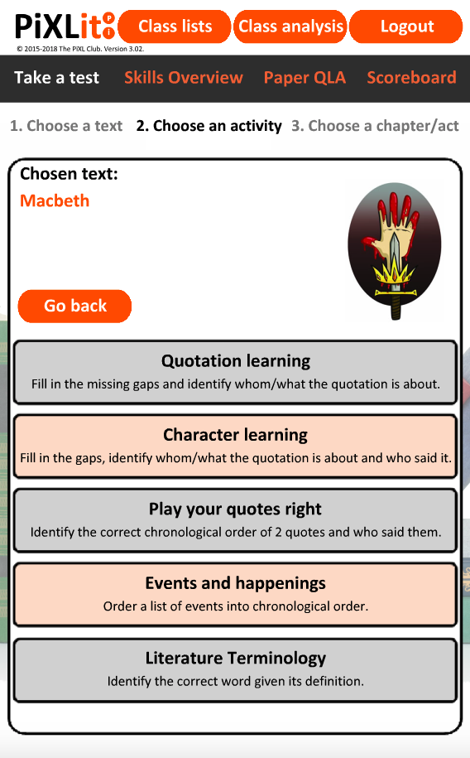
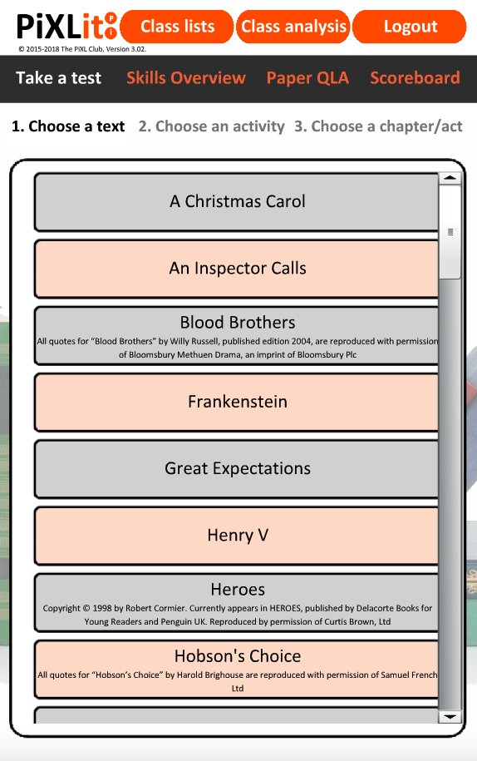
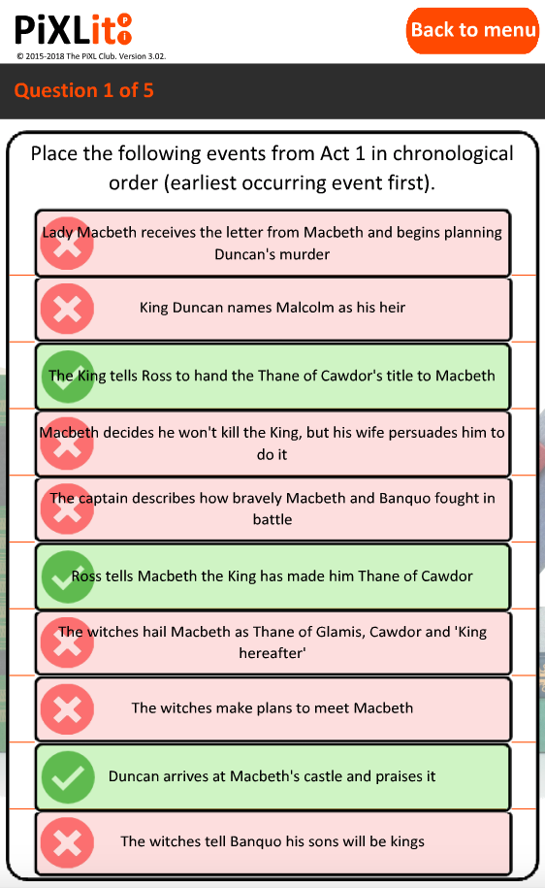
PiXLit App

Slide 21
PiXLit
Download the ‘PiXLit’ app
Login using the following details
School id: (Place PiXL username here)
User name: Surname & first initial
Password: Surname & first initial
Log in to the PiXLit
Click on ‘Design a test’, ‘Please select a book’, ‘Macbeth’, ‘Character learning’, ‘Act 1’, ‘Begin Test’ and then go for it and answer the question.
Click ‘Mark all’

Slide 22
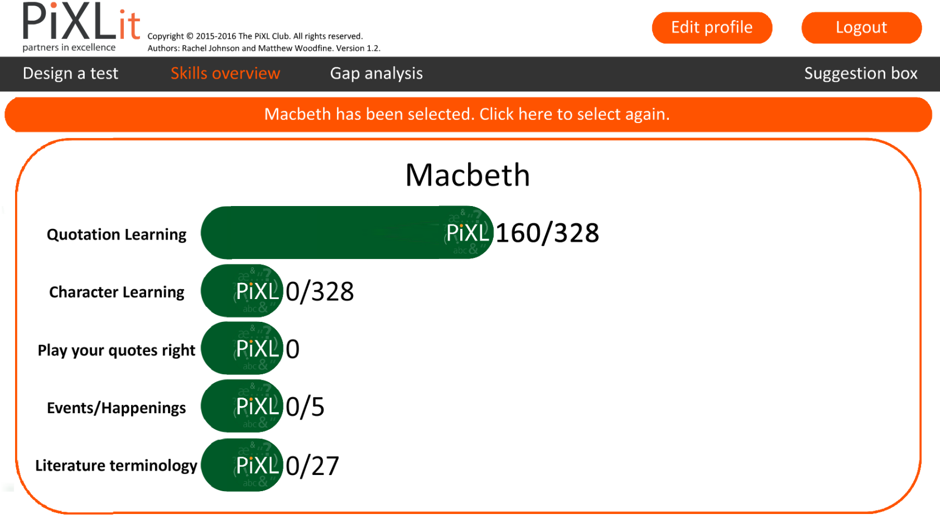
How far will your PiXL counters climb?
PiXLit

Slide 23
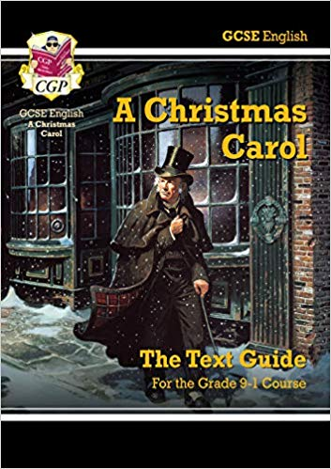
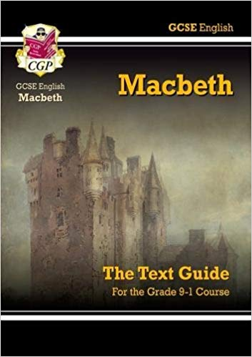
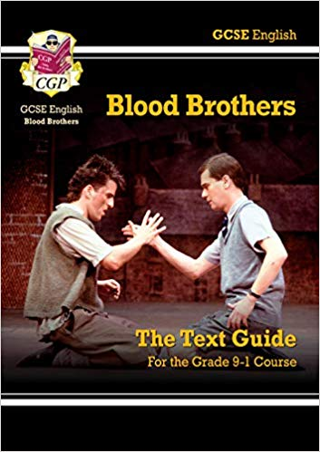
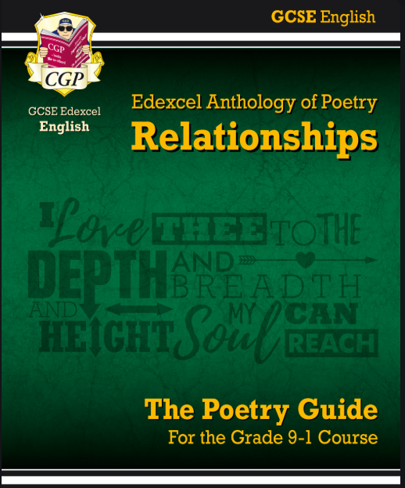
CGP Guides for all Literature texts are available.
We are compiling a Haydock Guide for January 2020.

Slide 24
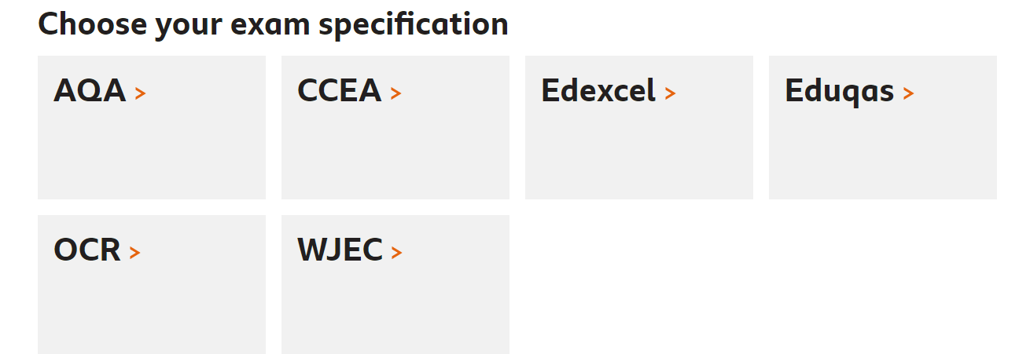
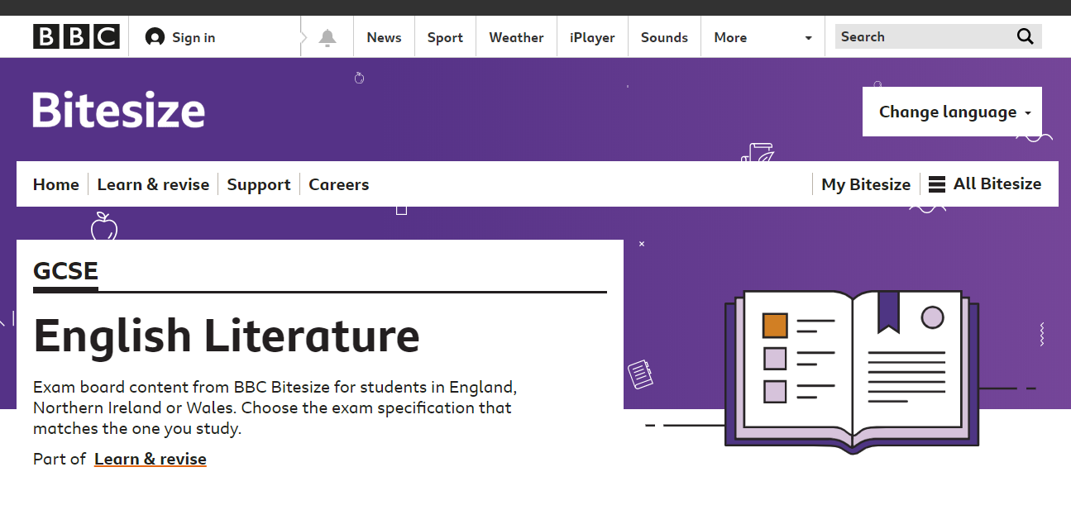
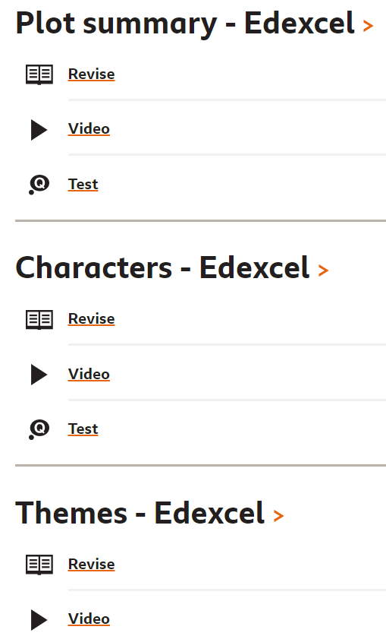
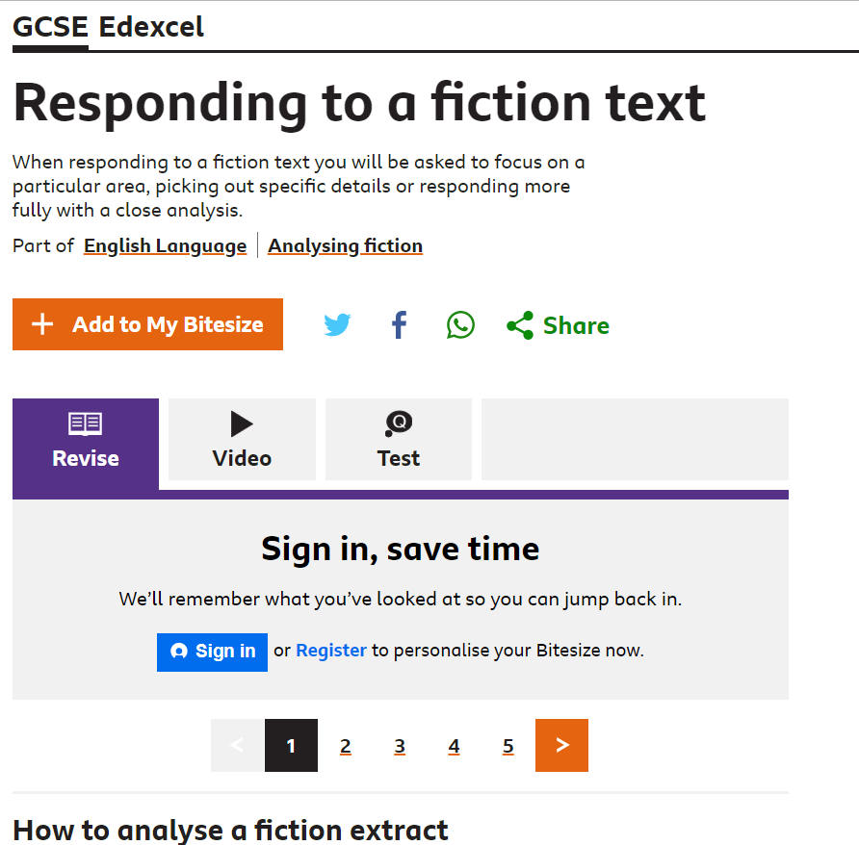
BBC Bitesize:
It’s the same for English Language.

Slide 25
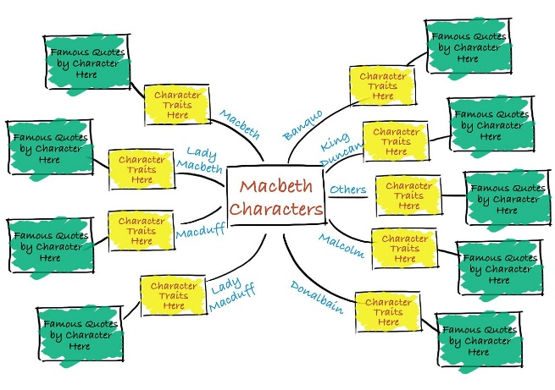
Other Resource Ideas:
Create Flashcards of key quotes, characters, themes and terminology.
Design Mindmaps / Lists of characters, plots, themes, and notes.
Create study groups where students discuss ideas and shape their opinions.
Please do talk to your teenager – get them to tell you about the books and characters, extracts and creative writing.

Slide 26
Thank you for your time. Mr Chris Chamberlain (Assistant Headteacher / Head of English) Contact: chambec@haydockhigh.sthelens.org.uk
Prepare to Succeed.

