Slide 1
Year 11 Success Event
Securing the best grades
Thursday 12/09/19

Slide 2
Yr. 11 Success Evening
Welcome - Mr Abram
Outline of the Evening
Be the best that you can be!
Becoming exam ready…
Year 10 Mock Results
Core Subject Guidance & Support

Slide 3
Best Results Ever!
132 grades 8 and 9.
In English 75% of students achieved grade 4+ and 20% achieved grade 7+
The tremendous achievement of individuals - Francesca Dyson who achieved a phenomenal 8 grade 9s and two distinction stars.

Slide 4
Results Day- August 2020
9 (A*+)
8 (A/ A*)
7 (A)
6 (high B) probably no problems, but some courses not accessible
5 (B/C) STRONG pass – not all A’ level courses – good for apprenticeships
4 (C) STANDARD pass – level 3 qualifications
3 or lower (D-G) will struggle to obtain apprenticeships and level 2 courses – re-sit maths and English

Slide 5
Mock Exams
25th November
How will you improve?
Do you have the correct resources?
Homework**

Slide 6
Additional Learning Opportunities
Mock Preparation
DON’T WORRY – YOU CAN GET YOUR A3 COPY TONIGHT

Slide 7
Holidays
End of exams? End of June - TBC after entries (probably 19th June)
Don’t miss Prom – Wednesday 1stJuly
Results day – Thursday August 2oth

Slide 8
Coursework
Needs to be completed by Christmas or earlier – e,g, Art, P.E., Engineering, Music, Drama, Animal Care, Business.

Slide 9
Number of Exams – average 26 per pupil
Balance between GCSE and BTEC to reduce workload and support outcomes.
We have already completed exams – this will make next year a lot easier.
More exams before February.

Slide 10
Revision
Sometimes the whole thing just looks too big to tackle.
And when something seems too big to tackle, often we don’t bother at all as we just don’t know where to start – we simply feel overwhelmed.
If we break it down into smaller chunks, however, it seems a lot more feasible for us to achieve it.

Slide 11
Knowledge Vs Familiarity
How well do you know the 50p coin?
You have seen it thousands of times, so you should know all about it.
Think about the front of a 50p coin (not the side with the Queen’s head). There is an image of Britannia.
What is in her left hand?
What is in her right hand?
What is on the shield?
What is on her head?
What is at her feet?

Slide 12
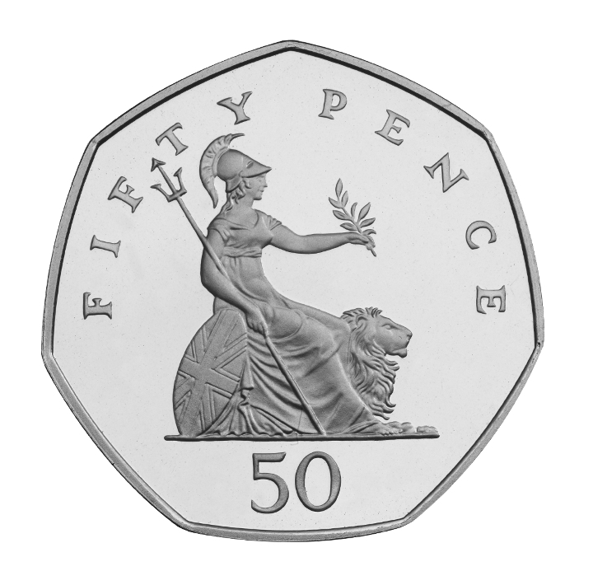
We have seen the coin many times (‘shallow repetition’) but we have not thought about it. Therefore we are familiar with it but we do not know it!

Slide 13
Stages of Revisions
Make a list of all the subjects you need to revise.
Make a list of each topic you need to revise for each subject (see worksheet – mock topics) This list should go in the front of your revision folders.
Make a detailed summary for each topic (mind map or set of revision cards). File these in a revision folder.
Retrieval practical – Go back through the topics again and again to try and memorise all the information on your revision summaries.
More retrieval practice – this is the key to success. Try to memorise each topic as many times as possible.
Exam practice – Use your revision summaries to attempt exam papers and exam questions.

Slide 14
Retrieval Practical
Retrieval practice is the act of trying to recall information without having it in front of you.
All current research is showing that no other technique (revision lessons, revision guides, re-reading) cements information into the long terms memory as powerfully as retrieval practice.
Some examples are:

Slide 15
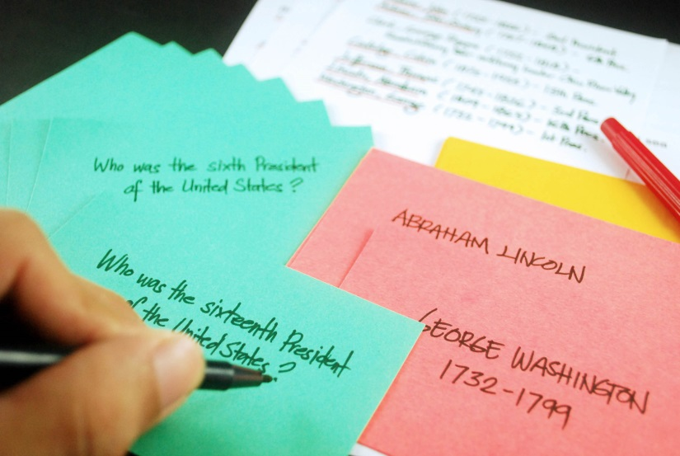
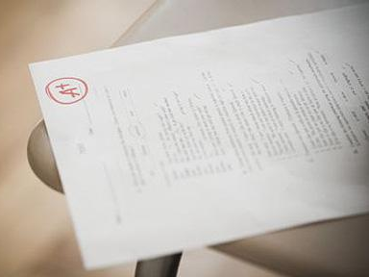
Past
Papers
Test what you already know (which will be lots!) by doing old exam papers.
Ask your teachers for the mark schemes and mark and annotate it using different colours. Then you can clearly see what went well and where you went wrong.
This basic technique stimulates all three learning styles as you’re learning by doing and then can have the opportunity for discussion with your teachers or peers.
Flashcards
Create colourful flashcards of key ideas/themes/ concepts.
You could write questions to test a friend.
This is great for the majority of subject areas, especially question based subjects like MFL, History, English, Science, Geography etc.

Slide 16
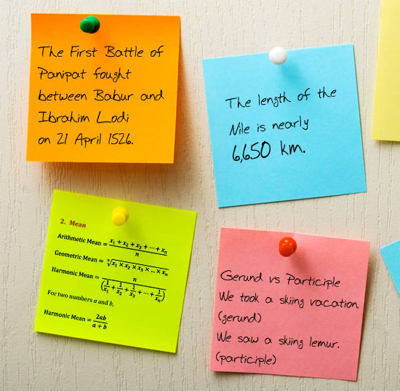
Flashcards
Create colourful flashcards of key ideas/themes/ concepts.
You could write questions to test a friend.
This is great for the majority of subject areas, especially question based subjects like MFL, History, English, Science, Geography etc.
Post-its
Write key information on post-it notes and place them around your revision area. You can:
• Colour code them for different subjects
• Group themes/topics together
• Organise them into what you know and don’t know – then rearrange as you revise and learn more

Slide 17
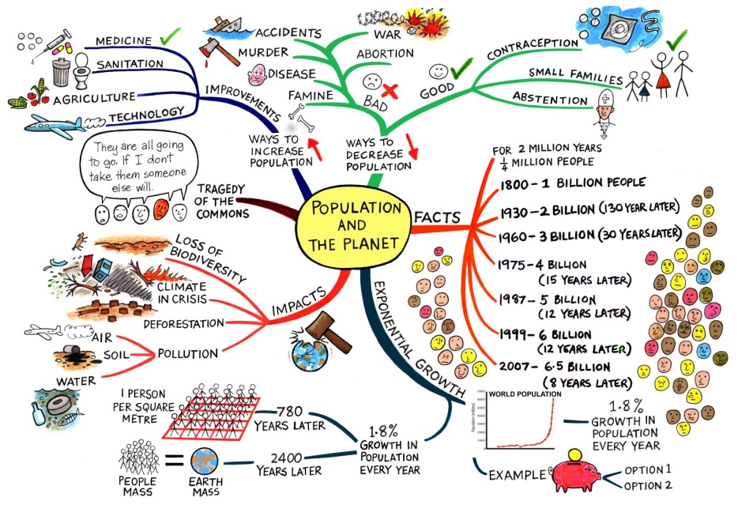
Mind Maps
Create Mind Maps with images and words related to each topic area.
The one pictured below is for Geography, but mind maps work in pretty much all subject areas.
Q & A
Devise questions and answers about a topic for other people and quiz each other.
You could do this on flashcards, as previously mentioned.

Slide 18
Year 11 Support Booklet
Key points
Passport to the Prom
Log of activities
2 hour independent challenge
Parent Log
Specifications

Slide 19
Phones

Slide 20
Important Dates
Date | Activity
13th September | Mock results received
13th September | Success Event
26th September | Cowley Sixth Form Open Evening
30th September | Assessment Point 1
25th October | INSET DAY – WORK DAY
November | Assessment Point 1 data issued
28th October | Half term Revision
25th November | Mock Examinations start
16th January | Year 11 mock results distributed

Slide 21
Mock results
Room 3/ 3a for important Maths, English and Science

Slide 22
Mock Results
Be determined
Put them on the fridge and then beat them
What you would have got if you sat your exams in year 10
Exam grades only (no coursework)
Current grade is usually higher
Some subjects did not do assessments eg PE
BTEC for some subjects is an actual grade eg animal care
GCSE is the mock exam result only –will improve on this. Will be lower than your typical grade in most cases
For BTEC- D2= 7, M2 = 5.5, P2=4, P1 = 2(approx)

Slide 23
Results Day
August 2020
9 (A*)
8 (A/ A*)
7 (A)
6 (high B) probably no problems but some courses not accessible
5 (B/C) STRONG pass – not all A’ level courses
4 (C) STANDARD pass -
3 or lower (D-G) will struggle to obtain apprenticeships and level 2 courses – re-sit maths and English

