Slide 1
Welcome to Key Stage Four
Mrs Finnigan
Assistant Headteacher

Slide 2
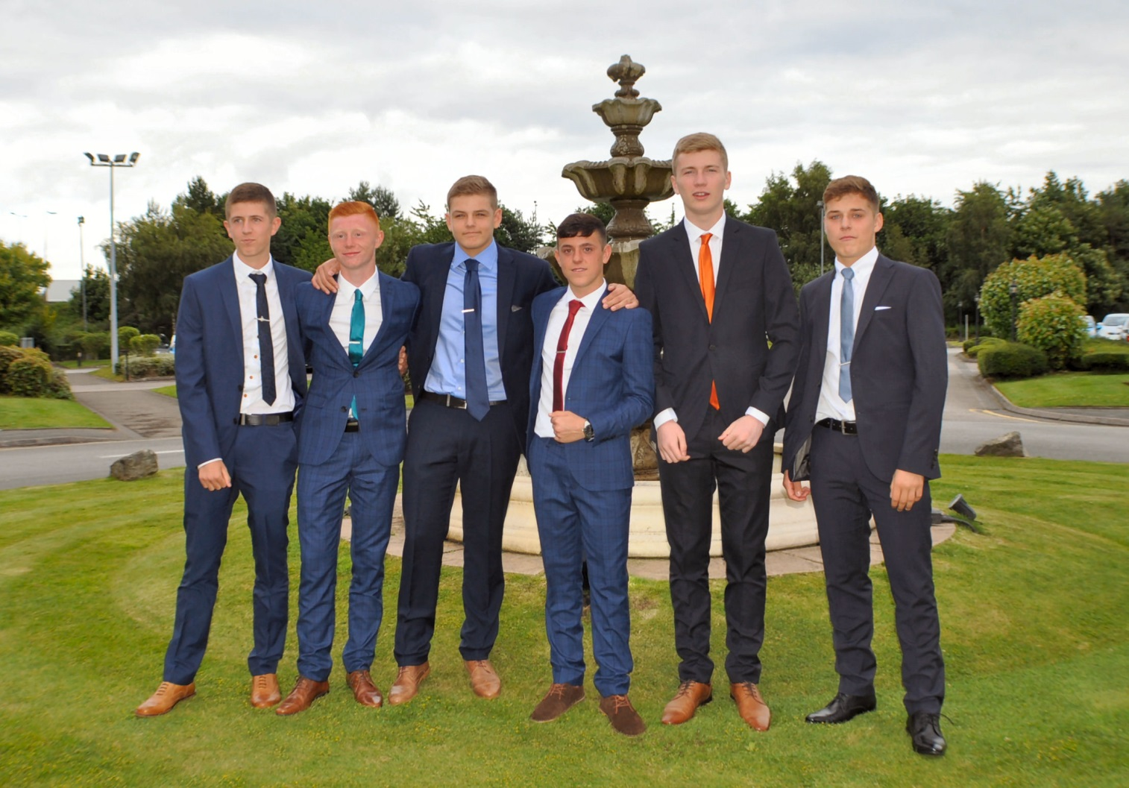

Slide 3
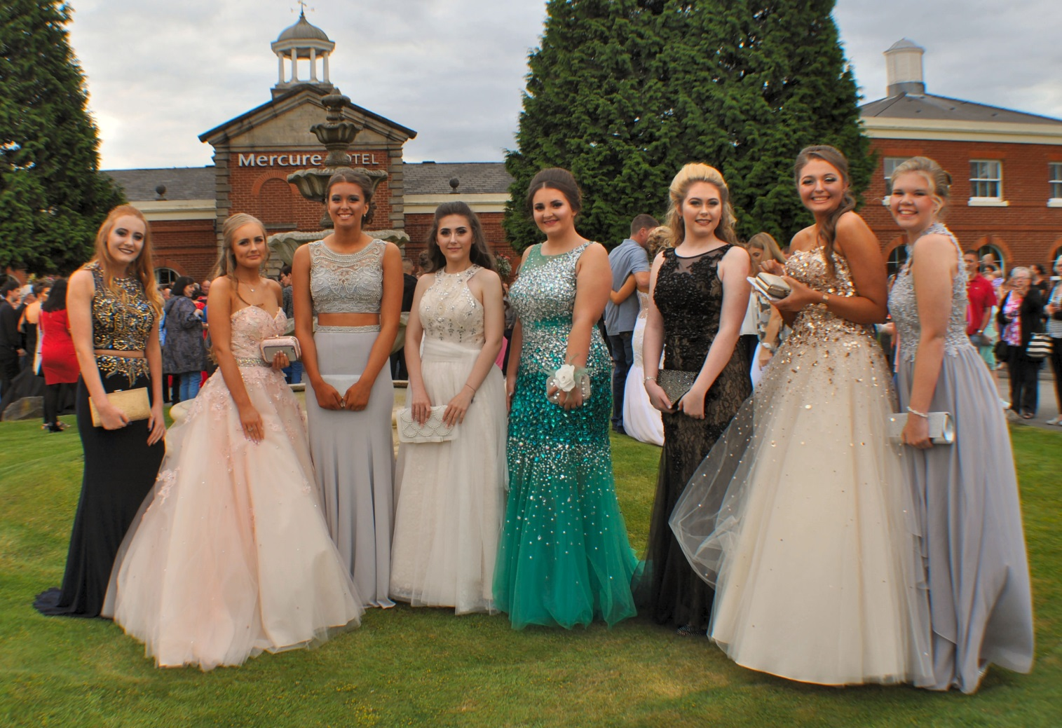

Slide 4
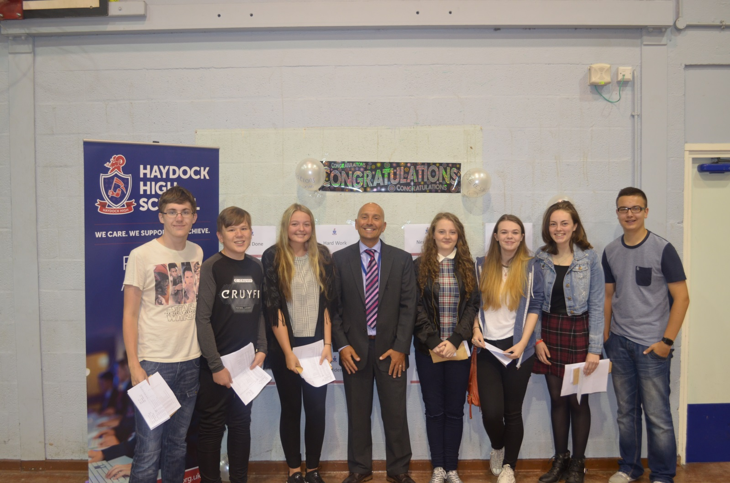

Slide 5
Examination Results and Successes 2016

Slide 6
Outstanding Progress Target (OPT)
Aim : Home and School partnership working towards outstanding progress

Slide 7
Changes
3 year key stage 4
Numbers rather than grades, national initiative
Year 11- grades, with numbers in English and Maths
Years 10 and 9 – a number
9 highest grade
Not to be confused with levels.

Slide 8
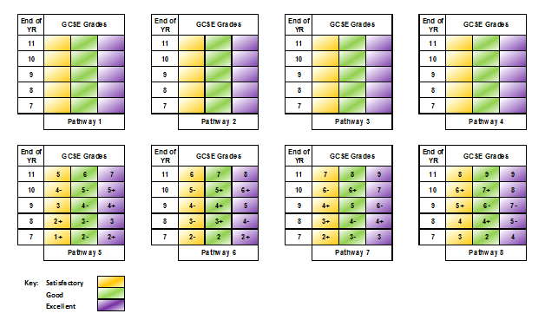

Slide 10
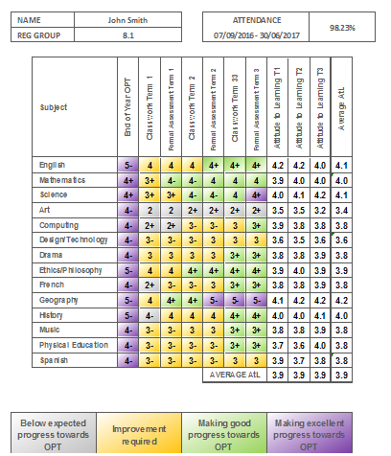

Slide 11
How can you support your child’s achievement and progress?
Discuss your child’s school work and progress regularly
Encourage your son/daughter to make use of resources at school, e.g. the learning resource centre
Check if you can buy or borrow the revision guides the school recommends.
Encourage your son/daughter to use revision websites recommended by the school.
If necessary, help your son/daughter to access and begin to use these websites.
Encourage re-visiting of lesson notes and re-reading of set texts.
Keep communicating with school, email Head of Department with concerns

Slide 12
How can you support your child’s achievement and progress?
If things are not going to plan:
Try to refocus your son/daughter on their longer term goals and targets and help him/her to identify the things to do to achieve these.
Talk to you son/daughter about whether he/she need support from others to get back on track, e.g. their teacher or Head of Year
Help him/her to pinpoint the problems to discuss with their teacher
Encourage your son/daughter to review his/her progress with you.
Be ambitious for the future

Slide 13
GCSE Maths

Slide 14
Changes to the Maths GCSE
Foundation Papers will be graded 1-5 and Higher Papers graded 4-9.
Greater subject content with new topics added to Foundation Tier
More problem solving style questions
Pupils will have to present arguments & proofs
Questions will regularly assess more than one area of maths

Slide 15
Subject content
Content | Foundation % | Higher %
Number | 25 | 15
Algebra | 20 | 30
Ratio & Proportion | 25 | 20
Geometry & Measures | 15 | 20
Probability & Statistics | 15 | 15

Slide 16
Assessments
Most students will entered for AQA GCSE
Foundation Papers will be graded 1-5 and Higher Papers graded 4-9
Each tier is tested by 3 exam papers.
Each paper is 1 hour 30 mins & 80 marks.
There is one non-calculator & paper two calculator papers.
All papers are weighted equally

Slide 17
Equipment
For each exam pupils should have:
Black Pen
Pencil
Ruler
Protractor
Compass
Scientific Calculator (Paper 2 & 3 only)

Slide 18
Useful Websites
Use the following websites for practice questions and video clips:
www.mathswatchvle.com
www.mathsbox.org.uk
www.justmaths.co.uk
www.mymaths.co.uk

Slide 19
GCSE English Language and Literature Overview

Slide 20
English Language 100% exam Two components to the exam. Each component is split into section A and section B. Component 1 (1 hour 45 minutes exam) 20th Century Literature Reading Study and Creative Prose Writing – 40%. Component 2 (2 hours exam) 19th and 21st Century Non-Fiction Reading Study and Transactional/Persuasive Writing – 60%.

Slide 21
English Literature 100% exam Two components to the exam. Component 1 (2 hours exam) Shakespeare and Poetry – 40%. Component 2 (2 hours and 30 minutes exam) Post 1914 Prose/Drama, 19th Century Prose and Unseen Poetry – 60%.

Slide 22
GCSE English Literature Texts Romeo and Juliet – William Shakespeare Blood Brothers – Willy Russell A Christmas Carol – Charles Dickens

Slide 23
GCSE Science

Slide 24
Yr 11 Science Pathways OCR Gateway
GCSE Science B & Additional Science B
Triple Science
- Biology
- Chemistry
- Physics
All exams are taken at the end of year 11

Slide 25
Paper 1
Paper 2
Controlled Assessment

Slide 26
Yr 10 GCSE Science Pathways- AQA
Combined Science: Trilogy
Triple Science
- Biology
- Chemistry
- Physics
All exams are taken at the end of year 11

Slide 27
Combined Science: Trilogy
Assessments
There are six papers: two biology, two chemistry and two physics. Each of the papers will assess knowledge and understanding from distinct topic areas.
There are 21 required practical investigations that students have to complete throughout the course- these are spread through the 3 disciplines.
A short section of the exam will focus on the skills & understanding from these investigations.

Slide 28
Biology, Chemistry & Physics
Assessments
For each GCSE within the Triple Science Pathway there will be 2 written exam papers. Each of the papers will assess knowledge and understanding from distinct topic areas.
Required Practical Investigations
Biology = 10
Chemistry = 8
Physics = 8

Slide 29
Equipment
For each exam pupils should have:
Black Pen
Pencil
Ruler
Scientific calculator
Revision guides for AQA Science will be available to order through Parentpay from Oct 1st.

Slide 30
Revision Techniques
In Science the revision techniques we use are:
- Topic specific revision lessons - - Revision Guides
- Practice exam question workbooks
- Past Exam papers
- Extended answer question practice
- IPAD revision apps
- Mindmapping
- Institute of Physics revision classes.

Slide 31
Useful Websites
BBC Bitesize
www.bbc.co.uk/bitesize/gcse/science
MyGCSEscience (Youtube tutorials)
https://www.youtube.com/user/myGCSEscience
Physics revision
http://www.darvill.clara.net/myon.htm
Science revision
http://www.s-cool.co.uk/gcse

Slide 32
Useful Apps
CGP Test and Learn App- Apple and Andriod £1.49 each
Available through the CGP website- cgpbooks.co.uk/apps

