Slide 1
World War II
By Trevor Rouch

Slide 2
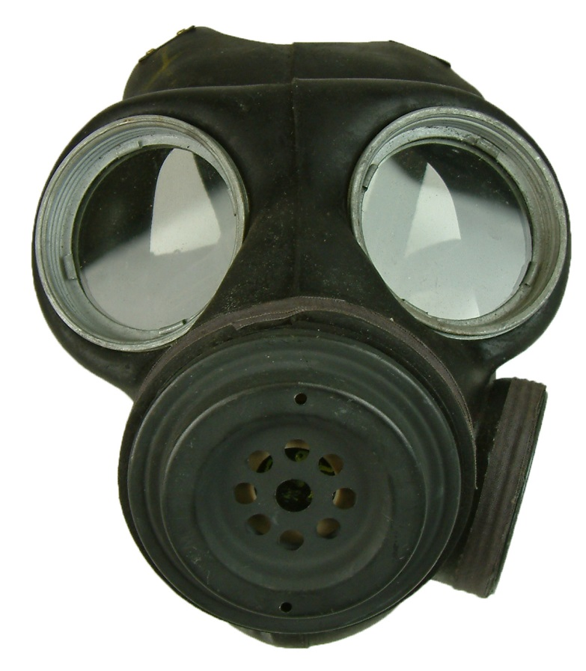
GAS MASKS

Slide 3
BLackoutS

Slide 4
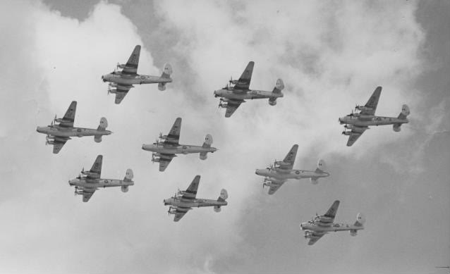
bombing

Slide 5
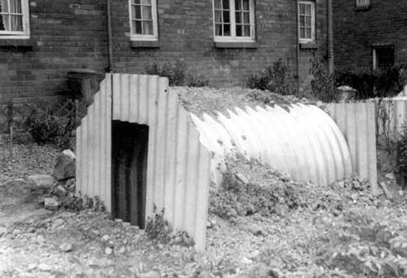
Shelters

Slide 6
Navy (merchant and royal )

Slide 7
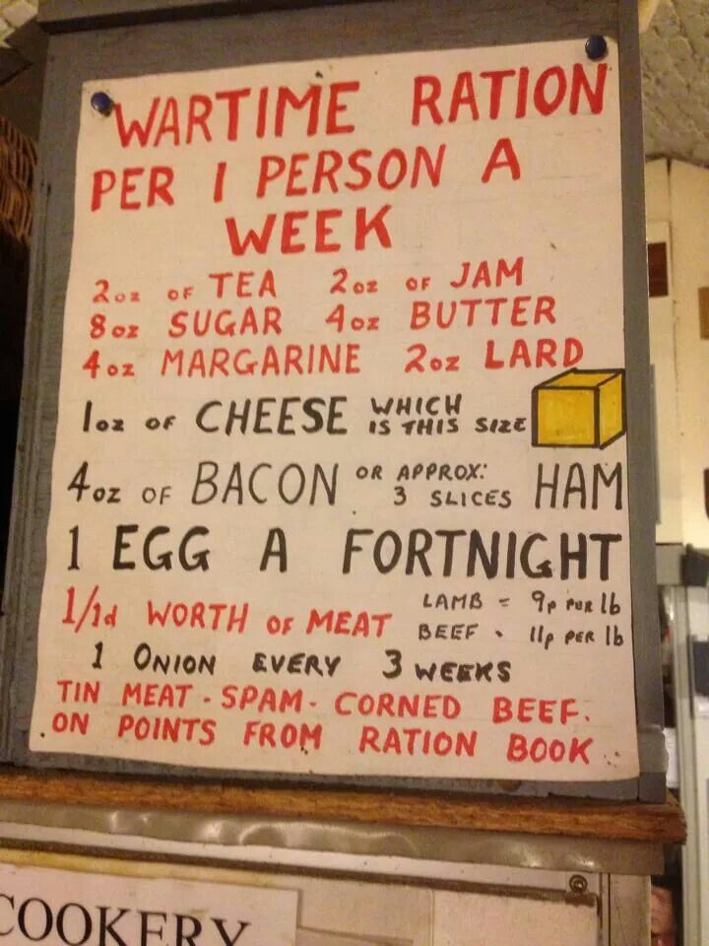
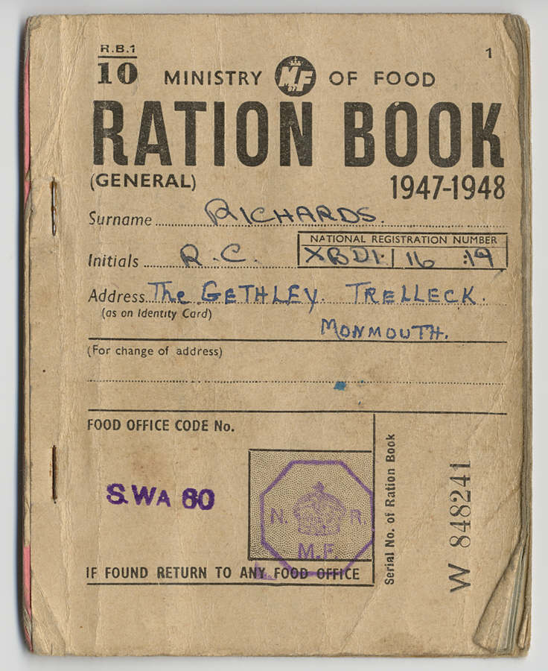
RATIONING

Slide 8
IDENTITY CARDS

Slide 9
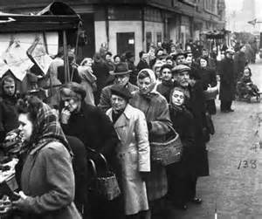
QUEUING

Slide 10
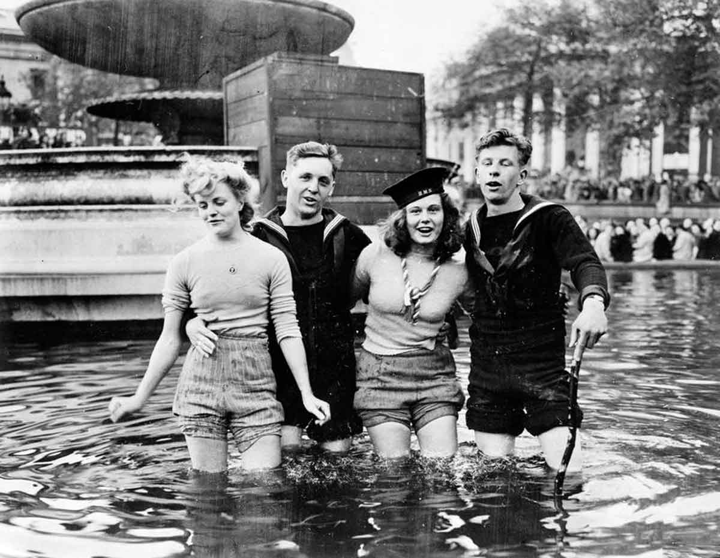
VE Day

Slide 11
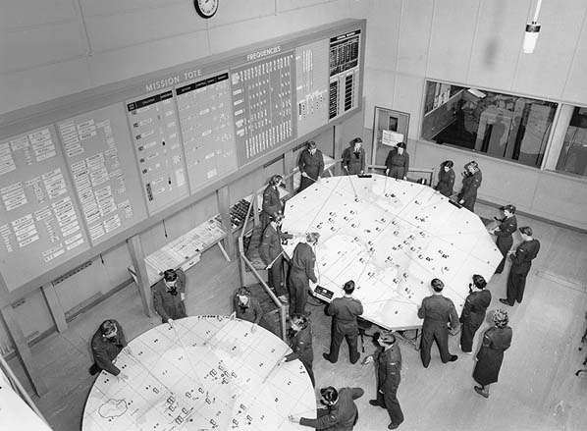
RAF – Operations Table

Slide 12
Potential threats

Slide 13
Grid Reference UK

Slide 14
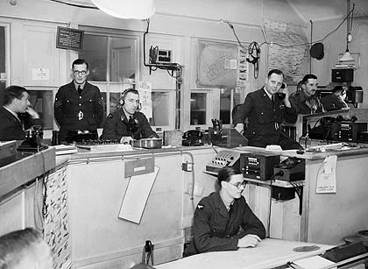
Fighter table

Slide 15
Grid Reference / VIP
VIP

Slide 16
Story ….
Tasker Watkins

